Slide 1

Zomato Restaurant Data Analysis
Analyze restaurant data across cities and cuisines to uncover customer preferences, pricing trends, and key business insights
Group members :
S P Shriram
Aditya
Pratap
Nazrin shashil

Slide 2
Introduction
The restaurant industry is highly competitive and rapidly growing, especially in urban cities.
Platforms like Zomato generate large amounts of data related to restaurants, cuisines, pricing, and customer behavior.
Analyzing this data helps in understanding customer preferences and market trends.
This project focuses on exploring restaurant data across multiple cities, cuisines, and price ranges.
The analysis aims to identify key factors affecting restaurant performance, such as ratings, cost, and services.
The insights derived from this dashboard can help businesses make data-driven decisions to improve growth and customer satisfaction.

Slide 3
Data Overview
Domain: Zomato Restaurant Data
Files: Zomato Restaurant Data.csv, country code.csv
Total Records: ~9000+
Key columns: Restaurant Name, Location , Cuisines, Average Cost for Two , Ratings, Votes
The dataset consists of 9.5k restaurants,140 cities ,15 countries ,1825 cuisines.

Slide 4

Objectives / KPIs
Country-wise Restaurant Distribution
City & Country-wise Restaurant Count
Restaurants Opened by Year , quarter wise trends
Price Range Distribution Analysis
Table Booking Analysis
Online Delivery Analysis
Cuisine wise analysis
Cities wise analysis
Rating distribution Analysis

Slide 5

Project Process
Step 1: Data Collection (CSV files)
Step 2: Data Cleaning
• Removed null values
• Handled missing ratings
• Removed duplicates
Step 3: creating calculate table for time line seris analysis(year, quarter, month, day) wise restaurant count
Step 4 : created a data modelling relationship between tables
Step 5: Data Visualization using power bi
Step 6: Insight Generation

Slide 6
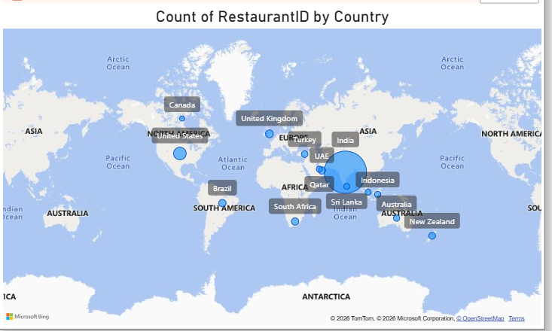
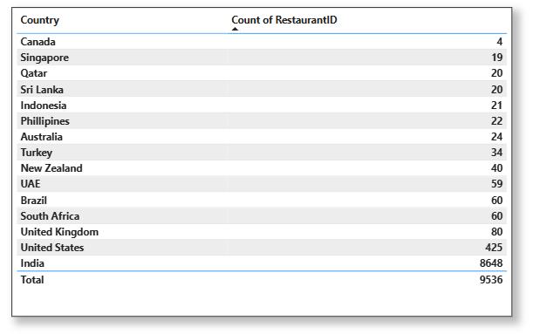
Country-wise Restaurant Distribution
India dominates the restaurant distribution:Food delivery platforms like Zomato have strong market presence in India, leading to more listings compared to other countries.
Most other countries have very small restaurant counts: Countries like Canada (4), Singapore (19), Qatar (20), Sri Lanka (20), and Indonesia (21) have very low counts. The dataset likely focuses on major or partner cities, not full national coverage.

Slide 7
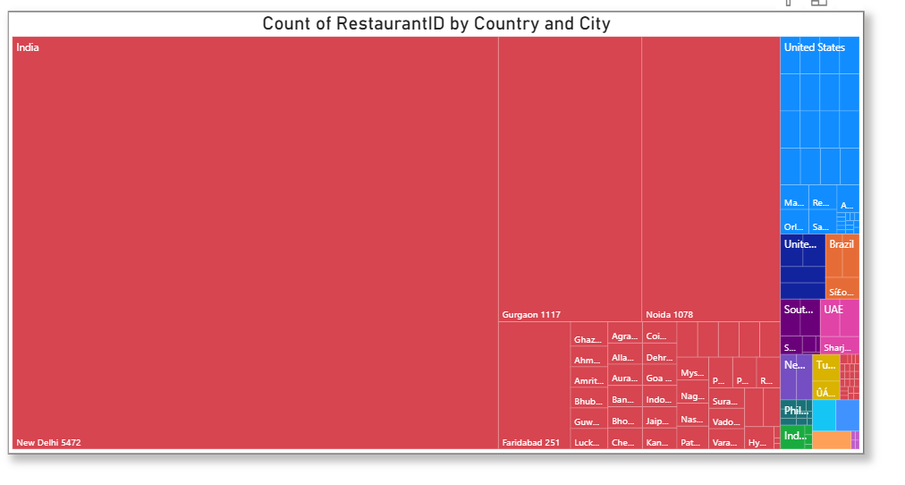
City & Country-wise Restaurant Count
Cities like New Delhi (5472), Gurgaon (1117), and Noida (1078) dominate. The dataset is heavily focused on Indian cities, especially the Delhi NCR region.
Countries like United States, Brazil, UAE, and others have much smaller sections compared to India.

Slide 8

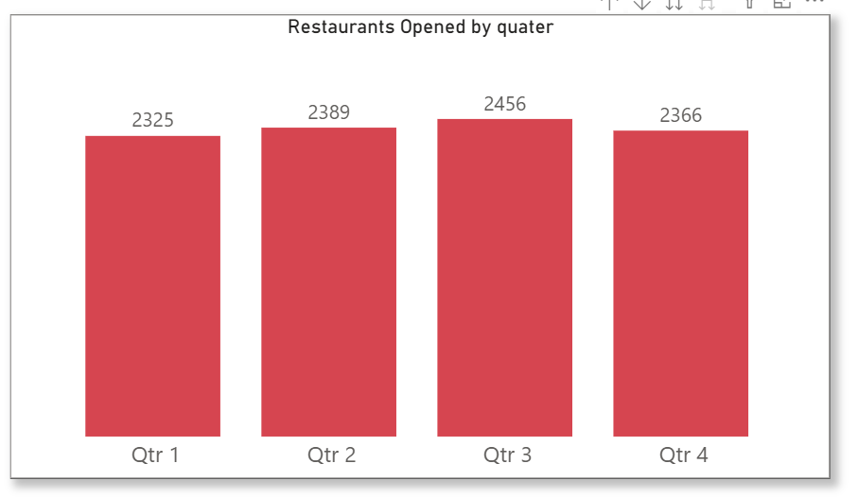

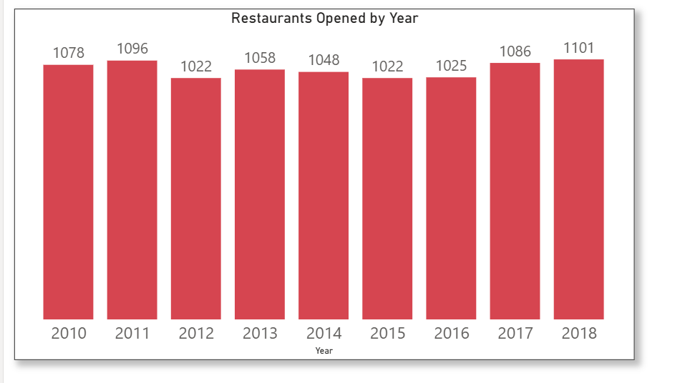
Restaurants Opened by Year , quarter wise trends
Slight increase in recent years (around 2017–2018): This suggests growing market expansion, possibly due to rising urbanization, food delivery apps, and changing lifestyle trends.
Quarter-wise distribution is almost uniform across all quarters: This shows that restaurant openings are not highly seasonal, and businesses are launched throughout the year rather than in specific periods.

Slide 9
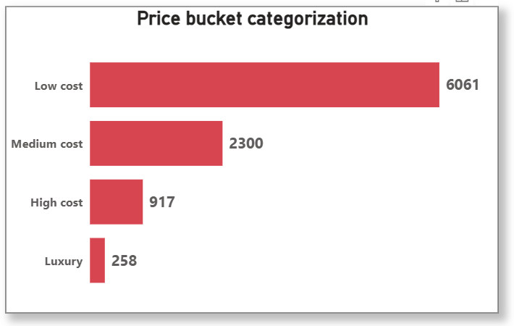
Price Range Distribution Analysis
Low-cost restaurants dominate the market : In countries like India, there is high demand for budget-friendly food, leading to more low-cost restaurant listings.
Medium-cost restaurants:Many urban customers prefer moderate pricing with better quality and ambiance.
Luxury restaurants:Luxury dining requires high investment and premium customers, which limits the number of such restaurants.

Slide 10
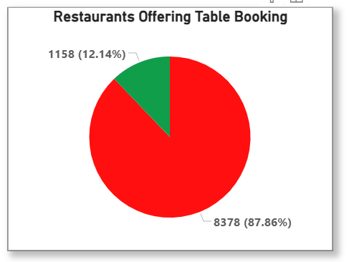
Table Booking Analysis
Majority of restaurants (87.86%) do not offer table booking: This is because many restaurants are small or quick-service outlets where advance booking is not required.
Only a small percentage (12.14%) provide table booking facility: These are typically premium or dine-in restaurants that focus on better customer experience and planned visits.
Low adoption of table booking indicates an opportunity for growth

Slide 11
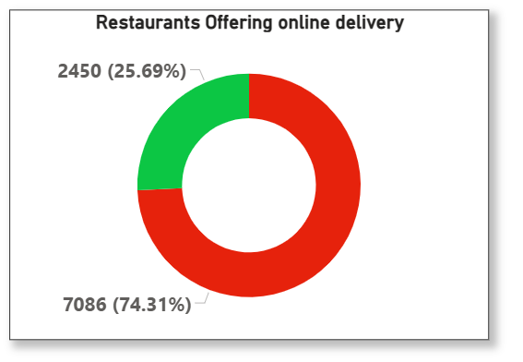
Online Delivery Analysis
Majority of restaurants (74.31%) do not offer online delivery: This is because many restaurants are dine-in focused or small outlets that may not have logistics or delivery partnerships.
Only around 25.69% of restaurants provide online delivery: These are typically urban, fast-food, or high-demand restaurants that benefit from digital orders and convenience.
The analysis highlights that online delivery is still underutilize creating a significant opportunity for restaurants to expand digitally and increase revenue.

Slide 12
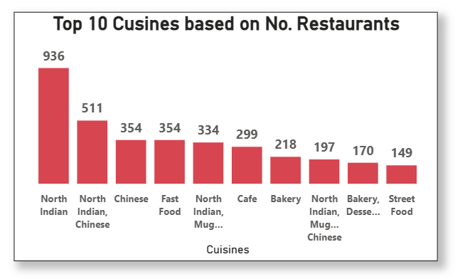
Cuisine Analysis
North Indian cuisine dominates the market: This is because it is widely preferred across India, offering familiar taste, variety, and affordability, making it highly popular among customers.
Fast Food and Chinese cuisines have strong presence: These cuisines are popular due to quick preparation, lower pricing, and high demand among younger customers and delivery users.
Combination cuisines (e.g., North Indian + Chinese) are also high : Restaurants offer multi-cuisine menus to attract a wider audience, increasing customer footfall and order value.

Slide 13
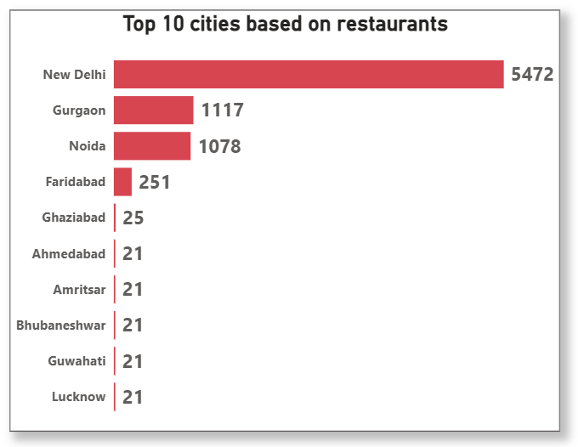
city-wise Analysis
New Delhi has the highest number of restaurants : It has high food demand, many commercial areas, and strong restaurant competition, leading to more listings.
Other cities have very similar and lower restaurant counts : These cities may have limited coverage in the dataset.
The platform likely focused more on major metropolitan regions like Delhi NCR compared to smaller cities.

Slide 14
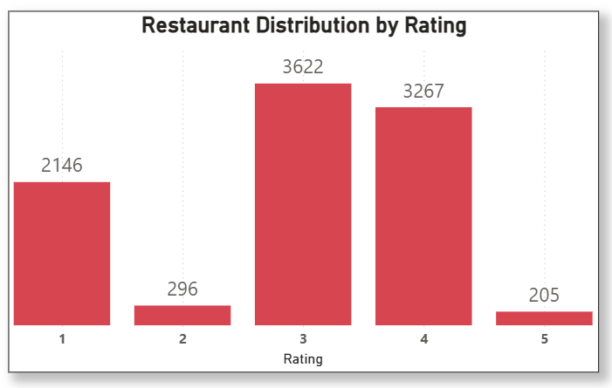
Rating Distribution
Majority of restaurants fall in mid ratings (3 & 4) : This indicates that most restaurants provide average to good service, but very few deliver an exceptional experience to reach rating 5.
Presence of low-rated restaurants (1 & 2): This suggests issues like poor service, food quality problems, or negative customer experiences, which impact overall brand perception.
Low number of 5-star ratings: This could be due to high customer expectations, inconsistent quality, or lack of premium service, making it difficult for restaurants to achieve top ratings.

Slide 15

Recommendation & Key insights
Expand in high-demand cities like New Delhi, Gurgaon, Noida since they show strong restaurant concentration and customer demand.
Focus marketing in low-count cities (like Ghaziabad, Amritsar) to capture untapped market opportunities.
Invest more in North Indian cuisine as it has the highest demand and market presence.
Differentiate in saturated categories (Fast Food, Chinese) by offering unique menus or pricing strategies.
Introduce table booking feature for more restaurants to improve customer convenience and increase premium bookings.
Promote booking-enabled restaurants through offers to increase advance reservations and better capacity planning.
Identify growth trends and align expansion plans in years with high growth patterns.
Analyze drop/stagnation years to understand market challenges and avoid similar risks in future.
Focus on low-cost segment as it dominates the market and attracts more customers
Introduce mid/high-range offerings with better experience to increase profitability and margins
Improve quality in low-rated restaurants (1–2 rating) by focusing on service and food quality.
Improve average rating (currently ~2.9) by focusing on customer satisfaction and feedback systems.

Slide 16

Conclusion
The analysis of Zomato dataset reveals focusing on high-demand cities, improving low-rated restaurant performance,
Overall, the dashboard highlights the need for quality improvement, strategic expansion, and better customer experience to drive growth
There is high competition in popular cuisines and cities, requiring differentiation strategies.
A large number of restaurants have ratings below 3, highlighting quality and service gaps
This analysis helps businesses take data-driven decisions to improve performance, enhance customer satisfaction, and identify growth opportunities

Slide 17
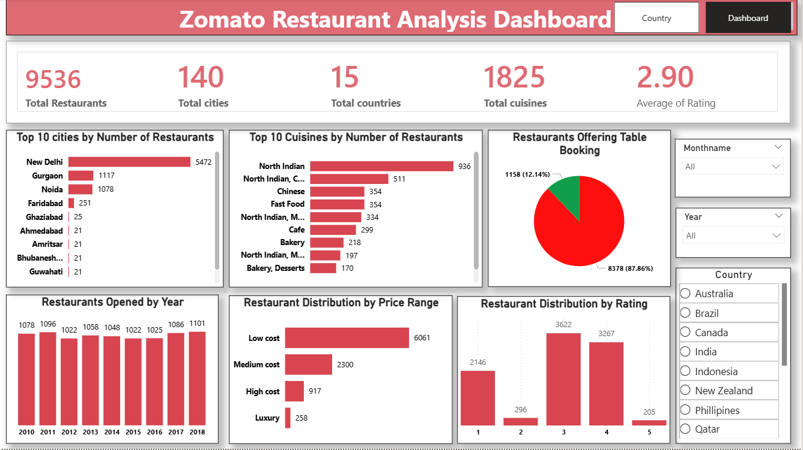
Dashboard
Purpose- To analyze restaurant data and generate actionable insights that help in understanding customer preferences, market trends, and business performance for better decision-making.

Slide 18
Dashboard Summary
The dataset consists of 9,500+ restaurants across multiple cities and countries, providing a comprehensive market overview.
Restaurant concentration is highest in metro cities, especially Delhi NCR, indicating strong demand in urban areas.
North Indian cuisine is the most dominant, followed by Chinese and Fast Food, reflecting customer food preferences.
Most restaurants fall under the low-cost pricing segment, showing that the market is highly price-sensitive.
The average rating is around 2.9, with most restaurants rated between 3 and 4, indicating moderate customer satisfaction.
A large percentage of restaurants do not offer table booking, highlighting an opportunity to improve customer convenience.
Overall, the dashboard highlights key areas for business improvement such as quality enhancement, strategic expansion, and better service offerings.
This dashboard provides actionable insights that can help restaurants improve performance and make data-driven business decisions.

Slide 19


